Slide 1



Twitter Bot Detection: Unveiling the Hidden Voices on Social Media
Twitter, a vibrant social media platform, has become an indispensable tool for communication, news dissemination, and opinion sharing. However, its vast user base has also attracted automated accounts, or bots, that can manipulate and distort the platform's dynamics.
by Gaurav Khumkar

Slide 2

Introduction
Twitter, with its many users and wide range of content, has become an important place to share information and have conversations. However, there is also a dark side to this busy digital space - bots. These automated accounts can have a big effect on how Twitter works, by making trends, spreading false information, and even changing people's opinions. In this presentation, we will talk about how to find and understand these hidden voices on social media.

Slide 3

Delving into the Dataset
The dataset we had a lot of labeled tweets that can help us understand how to identify and detect Twitter bots.
It has over 50000 tweets, so it's a great resource for understanding how people use Twitter and what their accounts look like.
The dataset also has a lot of different features, so we can learn a lot about Twitter bots from it

Slide 4

Data Cleaning: Preparing the Data for Analysis
Before we can start analyzing the data and building models, we need to make sure the data is clean and consistent
Data cleaning techniques: Handle missing values, Handle outliers, Handle inconsistencies
Imputation, normalization, and encoding are some of the techniques employed to prepare the data for further analysis and modeling.

Slide 5

Feature Engineering: Extracting Meaningful Insights from Data
Feature engineering is important because it helps us turn raw data into useful information.
In the case of Twitter bot detection, we can use features from user profiles, tweet content, and how people interact with each other to figure out which accounts are automated.
Techniques such as creating new features, combining existing features, and feature scaling are employed to enhance the predictive power of the data.

Slide 6

Exploring Machine Learning Models for Bot Detection
Machine learning algorithms offer powerful tools for classifying Twitter accounts as either human or bot.
In this presentation, various models, including random forests, support vector machines, logistic regression, decision trees, gradient boosting, and xg boosting, are evaluated for their effectiveness in detecting Twitter bots.
Each model has its strengths and weaknesses, and the selection depends on the specific characteristics of the dataset and the desired outcomes.

Slide 7
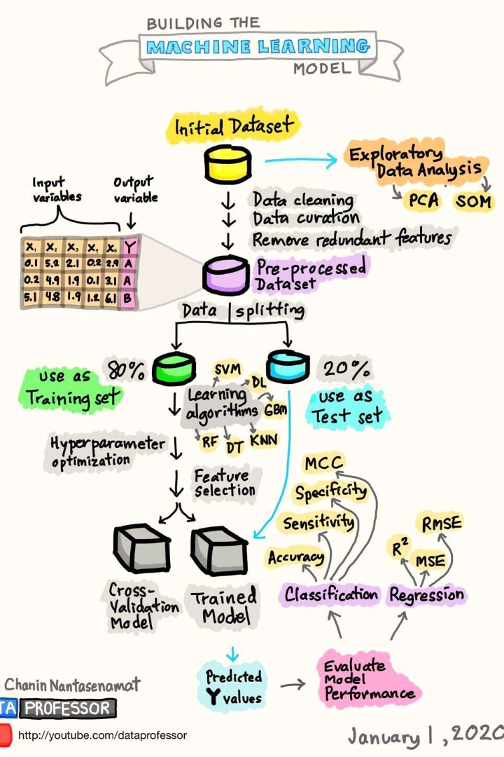
Model Training and Evaluation
The selected machine learning models are trained on the cleaned dataset, using the provided labels of human and bot tweets to learn the patterns that distinguish the two categories.
Performance metrics such as accuracy, precision, recall, and F1-score are employed to assess the effectiveness of each model in bot detection.
Based on the evaluation, the model that exhibits the best overall performance is chosen for further analysis.

Slide 8

Hyperparameter Tuning: Optimizing Model Performance
Hyperparameters are crucial settings that control the behavior of machine learning algorithms.
Tuning these hyperparameters involves finding the optimal combination that maximizes the model's performance.
Techniques such as grid search and random search are employed to efficiently explore the hyperparameter space and fine-tune the models.

Slide 9

Interpreting Model Results and Insights
Analyzing the trained model's performance provides valuable insights into the factors contributing to effective bot detection.
Feature importance measures help identify the most influential features in distinguishing bots from humans, allowing for a deeper understanding of the motivations behind bot creation.
These insights can inform strategies for improving bot detection and ensuring a trustworthy social media experience.

Slide 10

Conclusion: Ensuring a Trustworthy Social Media Experience
Bots can disrupt the quality of information, manipulate discussions, and spread misinformation.
By effectively detecting and removing bots, social media platforms can enhance the reliability and integrity of their content.
This ultimately leads to a more trustworthy and engaging social media experience for users, reducing the risk of harassment and abuse.
The model with the best overall performance in this presentation is the Gradient Boosting model, achieving an accuracy of 51%.

Slide 11

Thank You for Joining Us!
Thank you for attending our presentation on Twitter bot detection. We hope you found the information valuable and informative. If you have any questions or feedback, please don't hesitate to reach out to us. We look forward to staying in touch!

